Slide 1
Building Robust Ensembles
via Margin Boosting
Dinghuai Zhang, Hongyang Zhang, Aaron Courville, Yoshua Bengio, Pradeep Ravikumar, Arun Sai Suggala

Slide 2
Motivation
Boosting algorithms aim to iteratively learn weak classifiers and combine them as an ensemble to form a strong classifier.
Can we combine multiple base classifiers into a strong classifier that is robust to adversarial attacks?

Slide 3
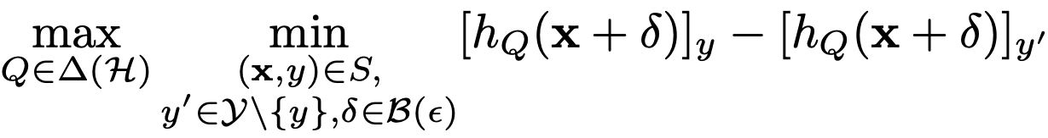


Margin-boosting framework
We propose a margin-boosting framework (Freund et al., 1996) for robustness
margin: $mg(h_{Q}, y, y^{′})$
distribution over $H$
set of base classifiers
perturbation
ensemble
some dataset
This is a two-player zero-sum game.
Freund, Y., Schapire, R. E., et al. Experiments with a new boosting algorithm. In icml, volume 96, pp. 148–156. Citeseer, 1996.

Slide 4
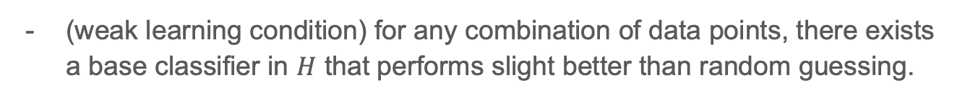
Optimality of margin boosting (informal)
We show that the following two arguments are equivalent:
(weak learning condition) for any combination of data points, there exists a base classifier in $H$ that performs slight better than random guessing.
the optimal solution of the aforementioned minimax game achieves perfect adversarial robustness.

Slide 5
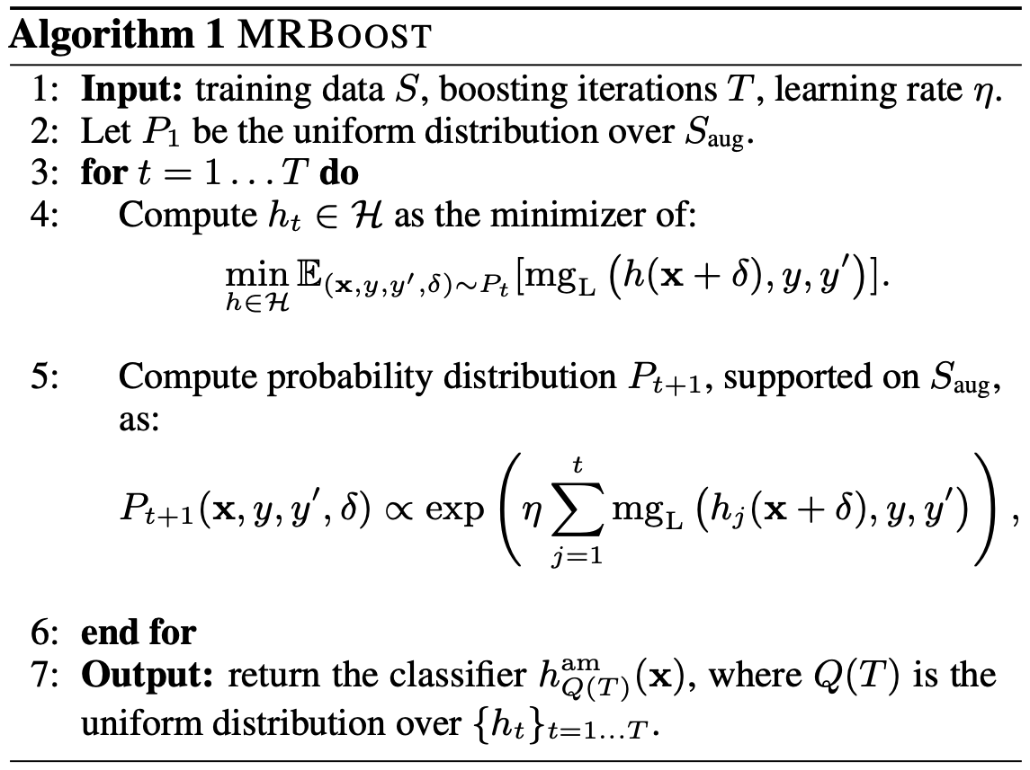
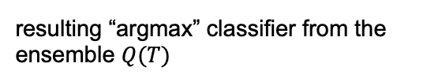
A Robust Boosting Algorithm
online learning framework
intractable 0-1 margin loss, need differentiable surrogate
need an efficient sampler
resulting “argmax” classifier from the ensemble $Q(T)$

Slide 6
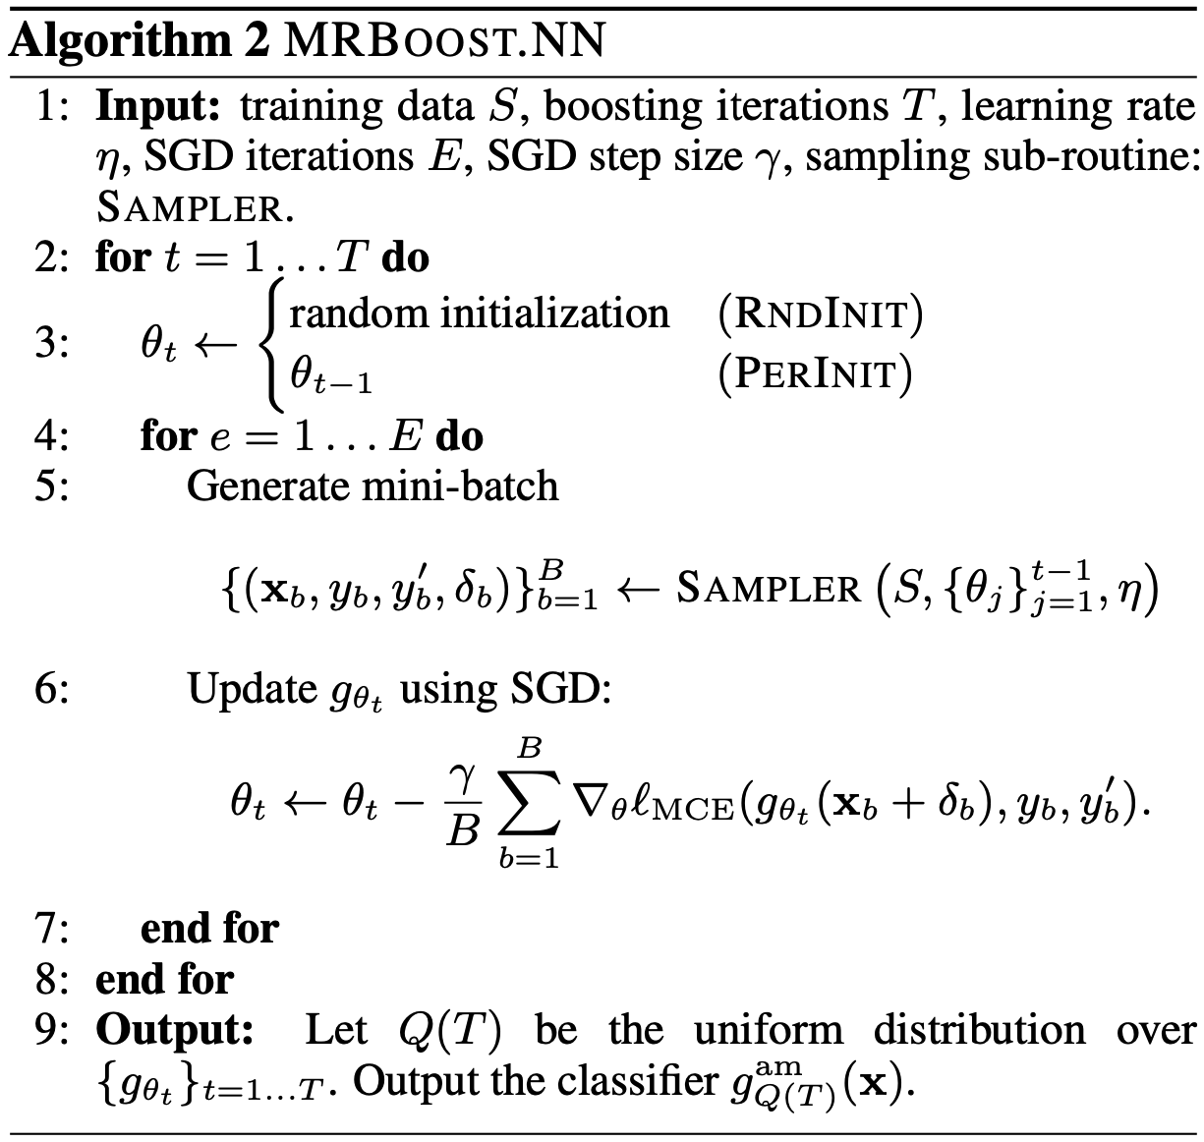

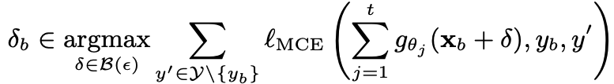
Practical MRBoost.NN algorithm
different initialization method
we propose the differentiable margin cross entropy loss

Slide 7
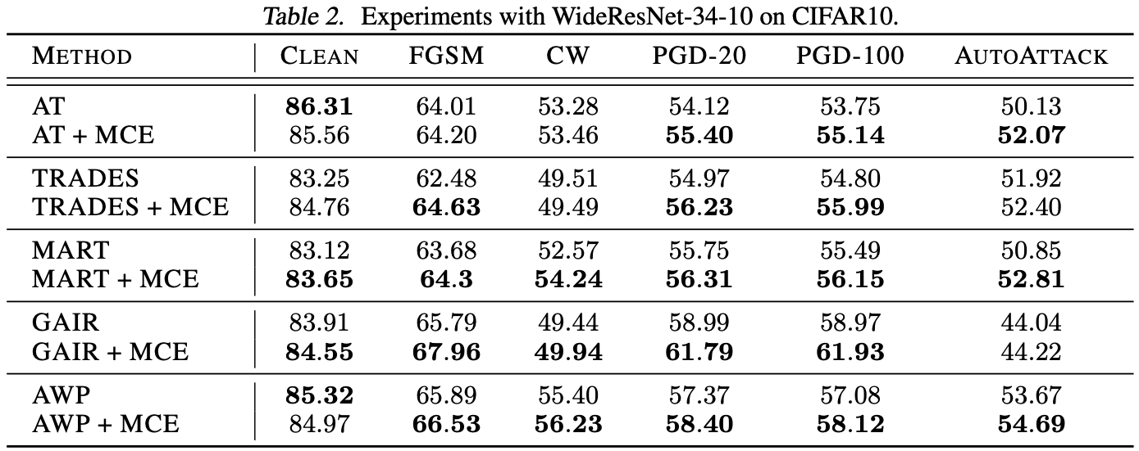
Experiment results
Single classifier case: the proposed MCE loss consistently increase the robustness of many previous algorithms (more details in the paper)

Slide 8
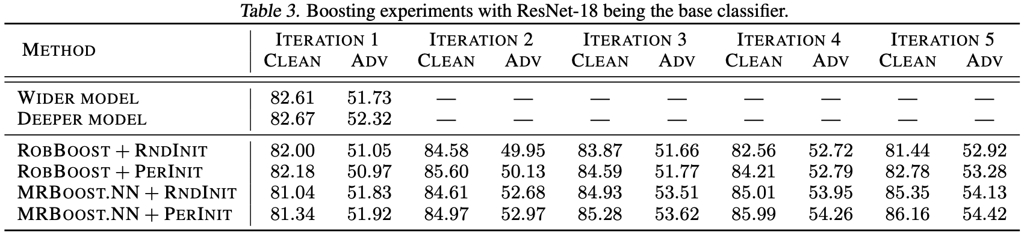
Experiment results
Multiple classifiers case: our proposed MRBoost.NN turns out to be a better robust boosting method than the baselines.

Slide 9
Thank you very much!

